Slide 1
The Battle of the Neighborhoods
David Boada

Slide 2
Description
The problem is about a person who wants to buy a house in Toronto. So he needs to analyze the neighborhoods of the city to know which one has all the requirements that he needs.
Mainly He needs a neighborhood where he can find at least 4 of the venues in the next categories:
Bar
Pharmacy
Gym
Bank
Coffee Shop
Restaurant
This problem is important because I can create a tool where the people can find their perfect Neighborhood using the Foursquare data. Most of the people care about not only the characteristics of an apartment or a house like number of bedrooms, mts, floor, etc... but they care about the neighbor to know what kind of places they are near for, or what kind of places they can go to.

Slide 3
The Data
I will use multiple data sources to solve this problem.
First, I will use the requests package to parse the data of a wikiedia page that contains all the information about the Postalcodes of Toronto, Canada including the Borough and the Neighborhoods.
Then, I will use the Geocoder package to find the coordinates for each Neighborhood. With the coordinates I can create a map to see the distribution of the neighborhoods.
Finally, I will use the Foursquare API to find the most common venues near each of the neighborhoods. With this data I will try to have a general description of the neighbor and I will select which has at least 4 of the categories that the client wants.

Slide 4
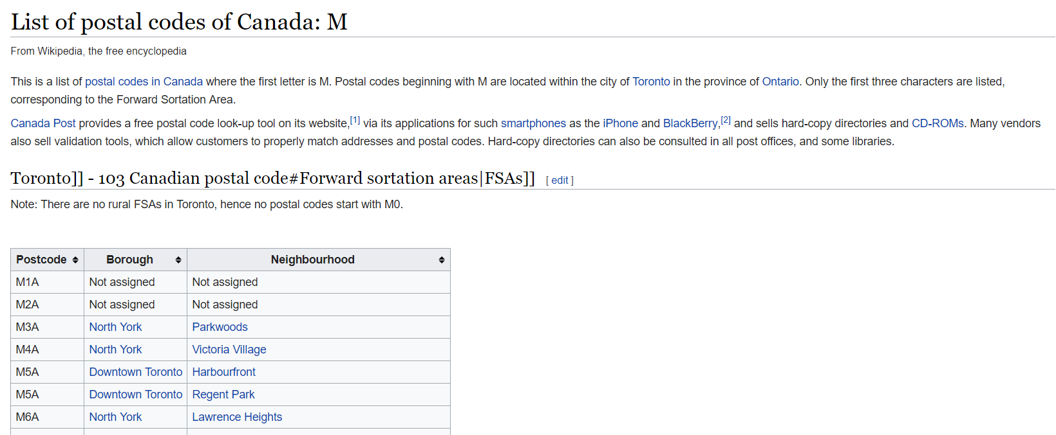
The process
In the next table you can see how is the data from Wikipedia.

Slide 5
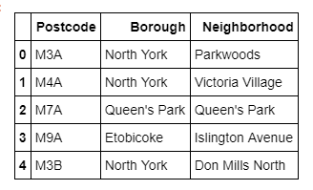
The process
I created a table with the following form:

Slide 6
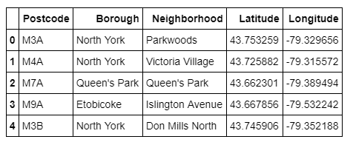
The process
Using Geocoder I could find the coordinates for each Postcode

Slide 7
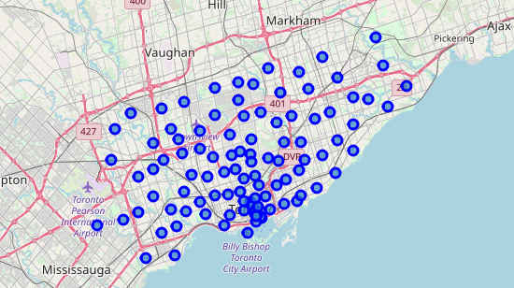
Map of the Neighborhoods

Slide 8
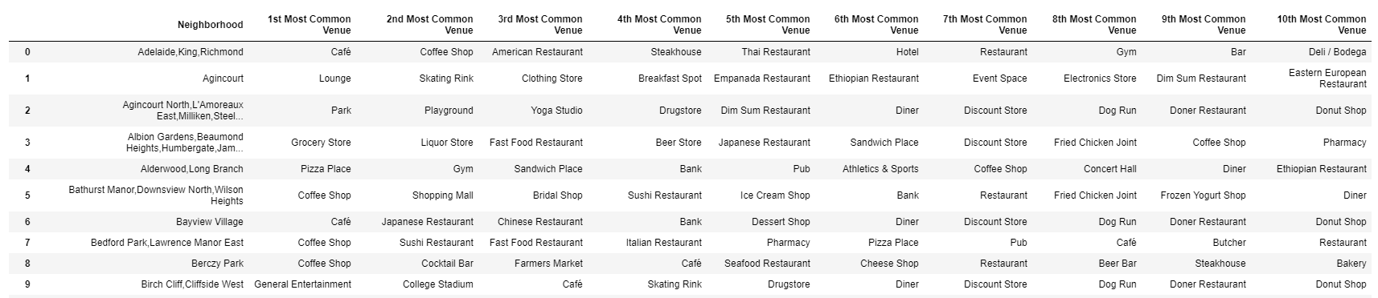
Top Venues

Slide 9
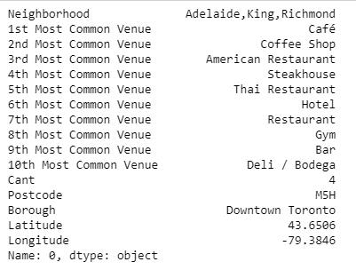
Selection
In this part I selected the neighborhood that have at least 4 of the required venues from the client.

Slide 10
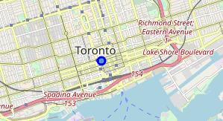
Results - Map

